Slide 1
Digitization of Selected Portions of the Burt Loescher Collection on Roger’s Rangers in the French and Indian War
Diane O’Connor, Project Coordinator
Ticonderoga Historical Society
Funded by a NNYLN Digitization Grant 2016-17

Slide 2
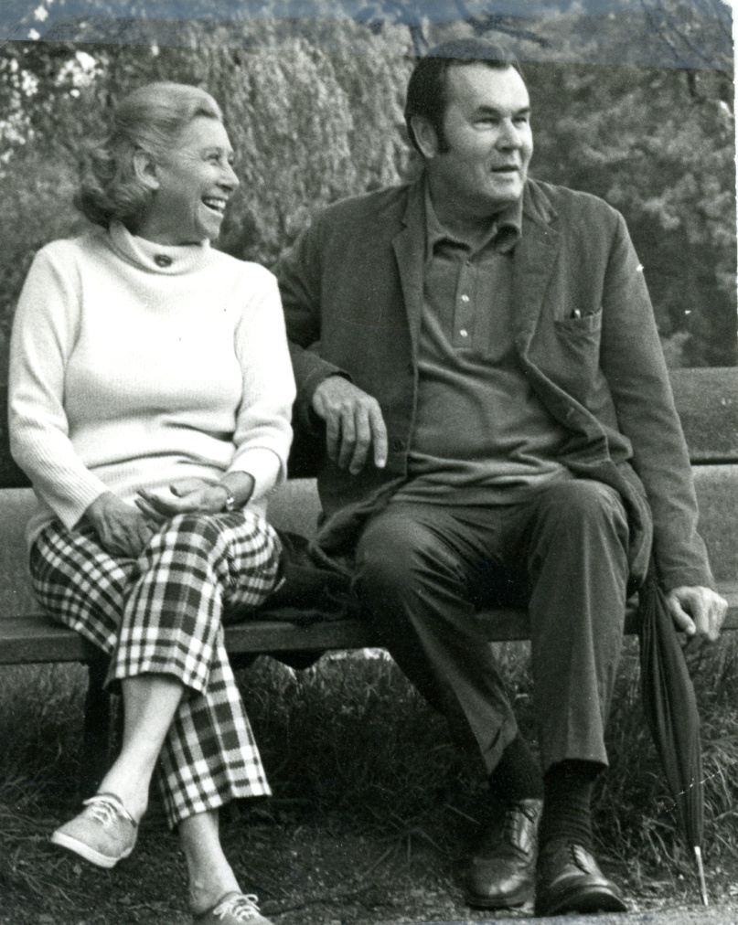
Burt Garfield Loescher
(1917-2006)

Slide 3
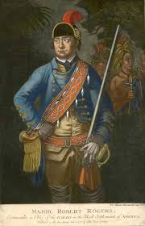
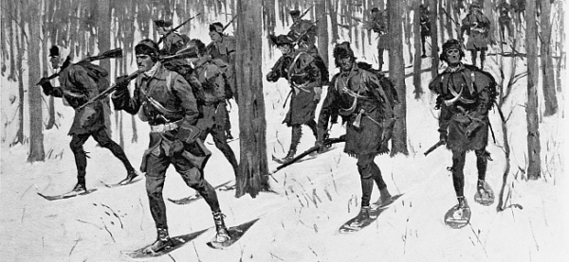
Robert Rogers
1731-1795

Slide 4
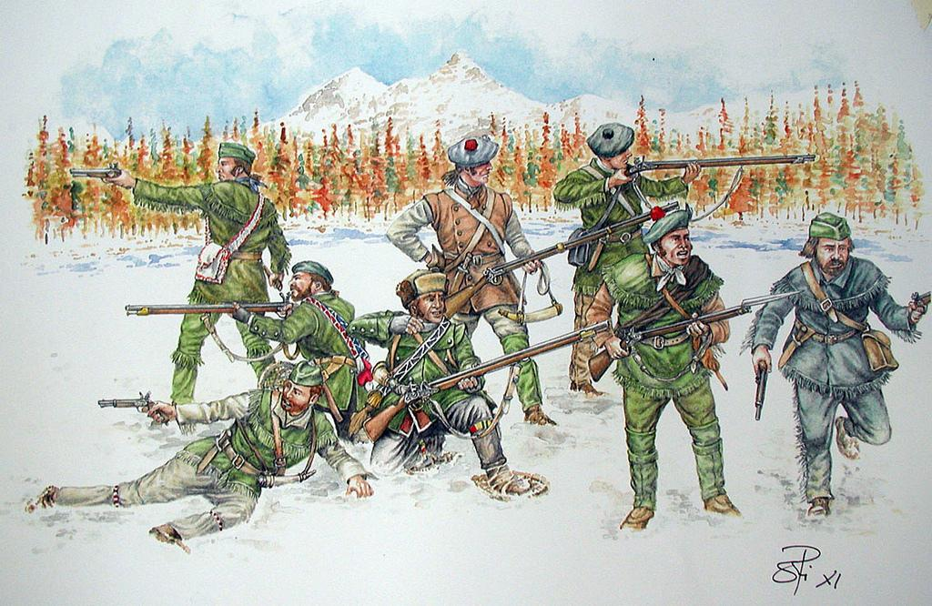
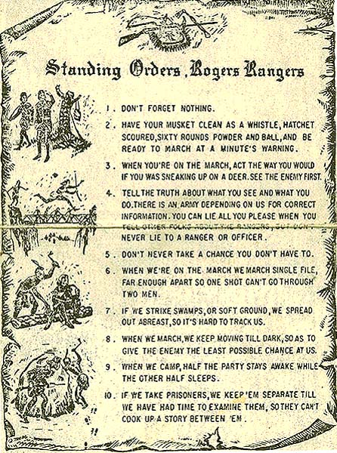

Slide 5
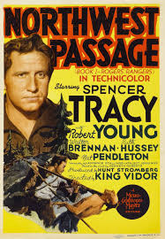
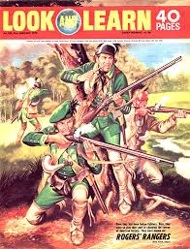
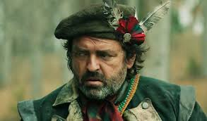
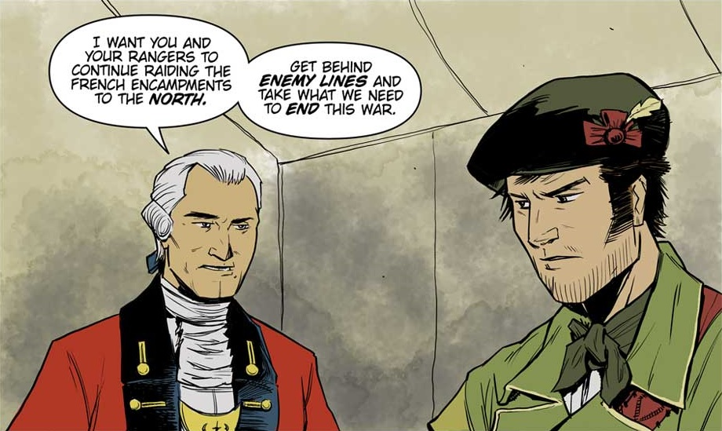

Slide 6
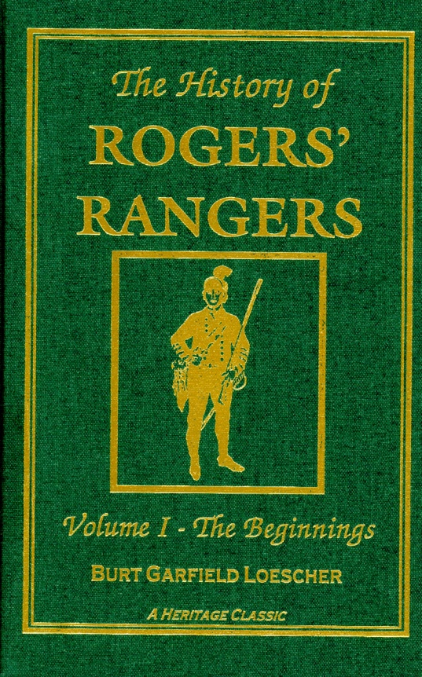
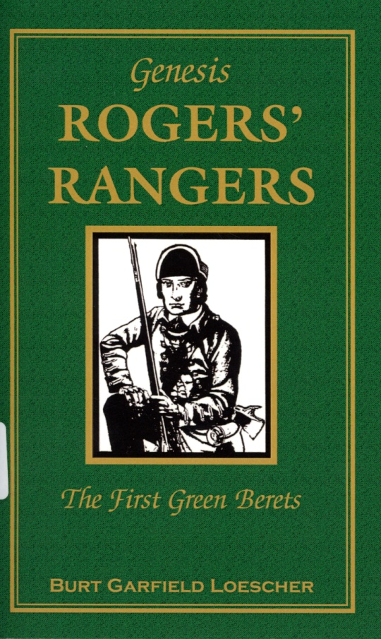
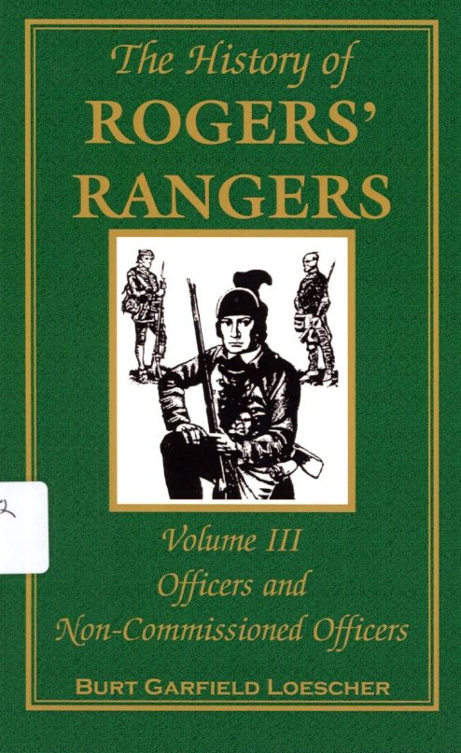
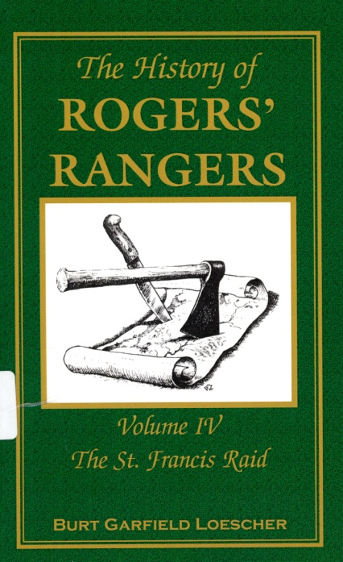

Slide 7
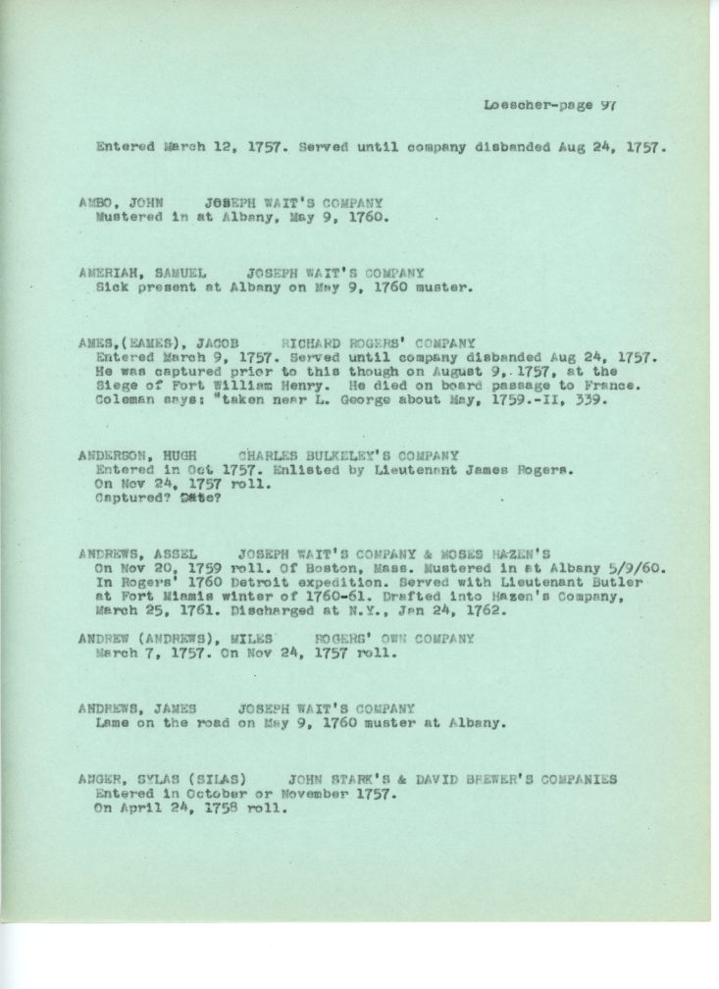
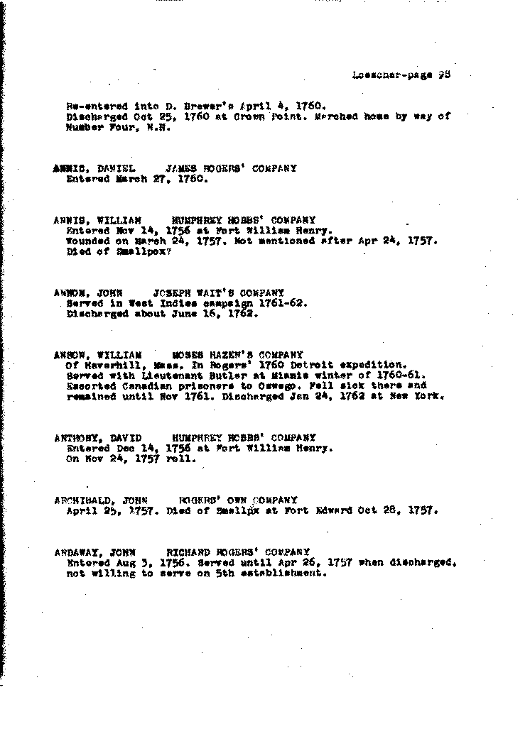
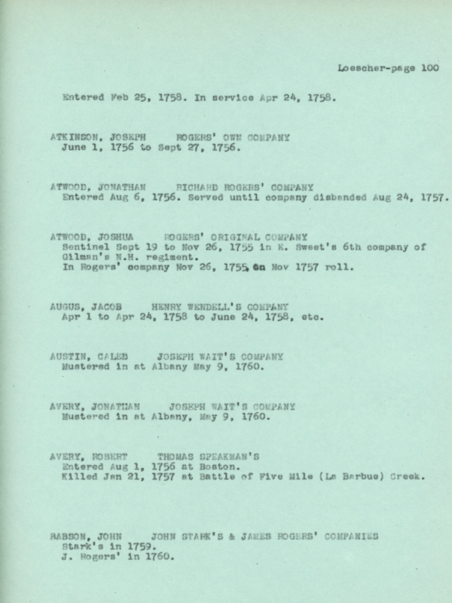

Slide 8
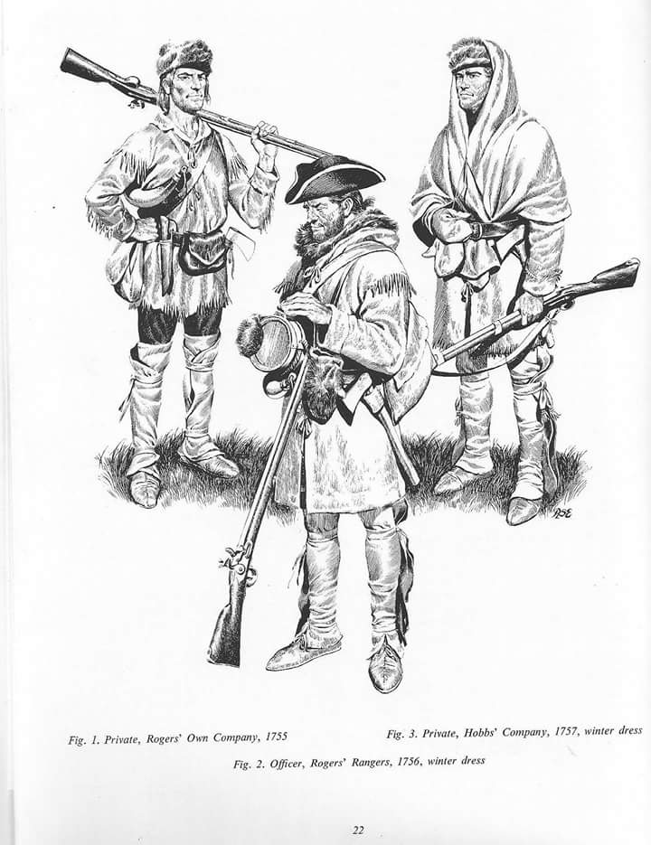
This digitization project included:
Previously unpublished rosters of Ranger Privates, including Native Americans and possibly African-Americans;
Loyalist officers who fought with Roger’s reconstituted Rangers during the American Revolution;
A previously unpublished manuscript “Explorers and Discoverers – Notable and Significant Events of the Rangers.” This material includes notes, maps and appendices that will be of great interest to researchers.

Slide 9
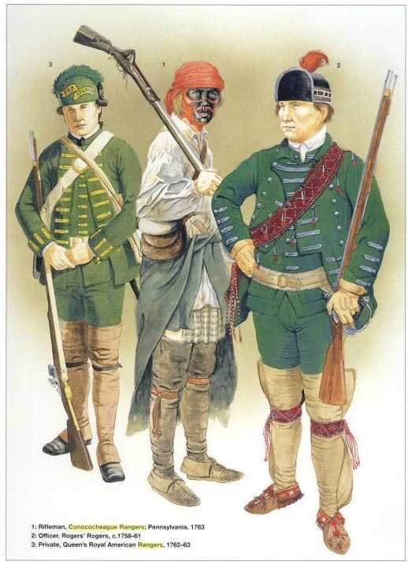
Because of this Grant:
More than 1700 individuals who served in two major American wars now have their place in history.
Notes:
fff

