Slide 1
Thousand Islands Arts Center Home of the Handweaving Museum
1967 - 2017

Slide 2
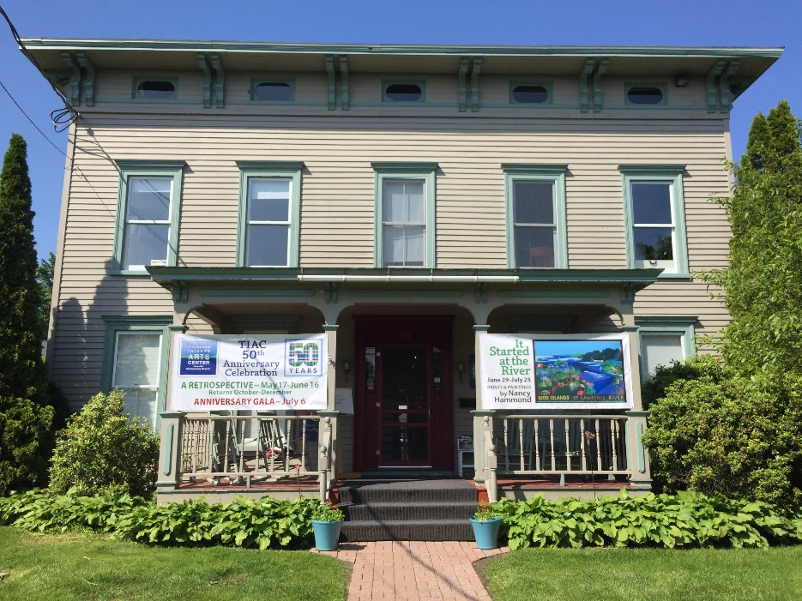
Who we are?
It is the mission of the Thousand Islands Arts Center to preserve and promote art and craft through education, instruction, exhibitions, and our permanent textile collection.
Notes:
Speak more on number of classes and exhibitions, staff board and volunteers, dine around

Slide 3
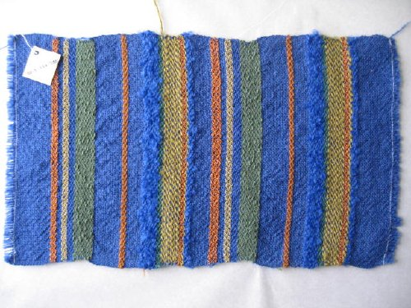
Background
We document and share the living history of handweaving.
Collections include woven samples, clothing, hangings, color studies, looms, tools, books, periodicals, personal, national and international studies, historic documents on textiles, studio notes, curriculum materials, photographs, correspondence, and scrapbooks, articles, and information on the craft before the publication of trade magazines.
John Landis international traveling exhibition case
Over 20,000 textiles from around the world
TIAC began digitization in 2010 (IMLS & NNYCF)
2014, 2015, 2016, 2017 awarded NNYLN grants
98.5.110.7.25 Plain Weave Sample from the Lucille Landis Collection, available on our website.

Slide 4
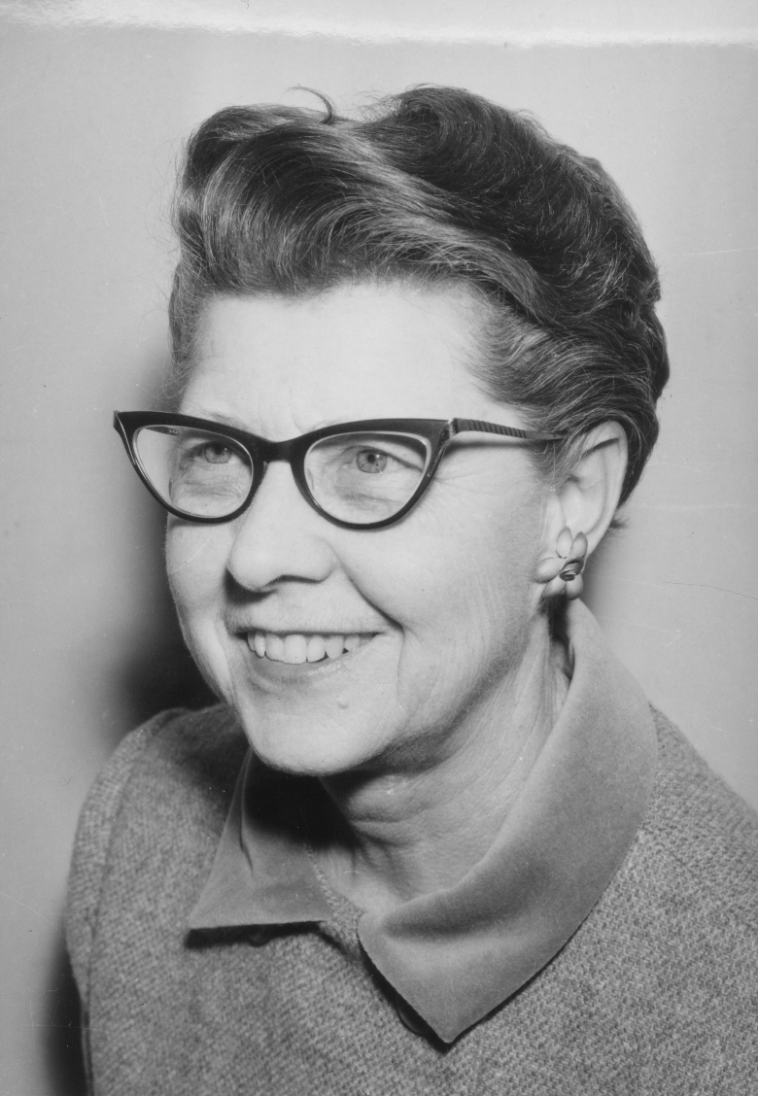
Goals
Begin Digitization of the vast Mary Snyder Collection
November 2016 - May 2017
Publish on TIAC database
Make available on NY Heritage website
Mary Snyder Collection includes:
Apparel
Woven pieces
Studio notes
Curriculum material
Scrapbooks
Photographs
Correspondence
Mary Snyder, 1960
Mary Snyder 1960

Slide 5
Mary Elizabeth Snyder 1907 - 2002
Mrs. Snyder donated her enormous collection of textiles, weaving studies, books, periodicals, tools and equipment to the Handweaving Museum.
She wove day and night and had contracts with leading houses such as Neiman Marcus.
Earned a masters degree in weaving at age 65 from the University of Kansas.
Worked as a weaver for NASA, and also taught at the University of Kentucky; University of Banff; University of Kansas; and the Chautauqua Institute.
Mary wove for 70 years, and, at age 88, pulled up roots in southern California to settle in Clayton near her collection and weavers.

Slide 6
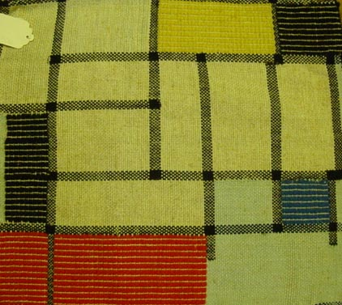
Methodology- Accession Procedures
Staff & volunteer involvement: Leslie Rowland, Executive Director; Sonja Wahl, Curator Emerita; Jessica Phinney, Curator; Marilyn Hutchinson, consultant; and Chris Murray, photographer
Artifacts selected
Descriptions written
Accession tag hand-sewn in to textile or affixed to manuscript/item
Logged in accession book and given accession number
Catalog card filled out
Photographed (x3)
added to PastPerfect
Artifact properly stored and location noted
Entered into PastPerfect computer database
Data to be submitted to NY Heritage website
& uploaded
Mary Snyder sample

Slide 7
The TIAC Staff and Trustees would like to thank the Northern New York Library Network. to learn more: TIArtsCenter.org Instagram @TIArtsCenter 314 James Street Clayton, NY 13624 (315) 686-4123

