Slide 1
A TRIP TO THE VENDOR/USER GROUP CONFERENCE
COSUGI 2017 in Salt Lake City, UT
Betsy Brooks, Automation and Technical Services

Slide 2
From the Dilbert Comic Strip, by Scott Adams

Slide 3
NNYLN’s Professional Development Grants are Invaluable

Slide 4
Some of the Benefits
Separating the hype from reality
Learning about what others are doing
Gaining some bargaining leverage
Getting energized

Slide 5
Salt Lake City
Home to the Family History Library of the Church of Latter Day Saints
And a beautiful public library

Slide 6
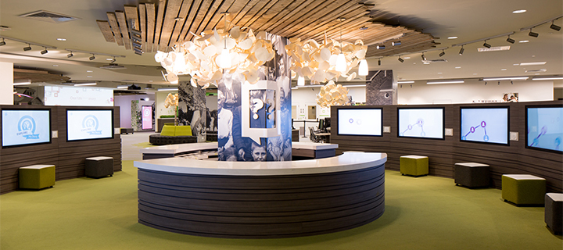
The largest library of its kind in the world, the Family History Library has a new Discovery Center on the main floor, with interactive, engaging experiences designed for families and youth groups.

Slide 7
Salt Lake’s City Library
…was designed by internationally-acclaimed architect Moshe Safdie and opened in February 2003. It has a six-story curving, walkable wall and a public plaza, with shops and services at ground level. A plaza offers views of the city and mountains, and there’s a roof-top garden and beehive, accessible by walking the crescent wall or the elevators.
When a group of us walked up the long wall to the garden, a model and a wedding party were being photographed against the beautiful background.

Slide 8
Official Conference Theme

Slide 9
Unofficial Conference Theme:
SIRSIDYNIX, Please FOCUS!

Slide 10
Most Impactful Presentation for Me:
Weird User Science: a presentation by two of SirsiDynix’s UI/UX designers
Takeaways:
1. The user experience should be fun, relevant, engaging, social and helpful (FRESH).
2. Emotional content is important, and more effective than informational content in drawing attention,
3. Choice is good, but too much choice is bad. About 5-7 choices on a page are the optimum number.
4. Break up data into groups so that it can be better understood.
These are some helpful principles to follow as we work on revamping our website and catalog.

Slide 11
Compare the experience of choosing between these: 2 week trip climbing mount Aconcagua
Take a cruise to the Bahamas
Take a cruise to Alaska
Visit your in laws
Visit your parents
Visit your kids
Visit your grandchildren
Climb mount Kilimanjaro
Go hiking on a local trail
Visit the giant redwoods
Visit the ruins in Italy
Climb in the Alps
Go bouldering in the local mountains
Go fishing in Alaska
Visit downtown NYC
Go to the local movie theater
Go see a broadway play
Take a wine tasting tour in California
Go big game hunting in Africa
Take a safari tour in Australia
Visit Hollywood
Play at the ocean in Las Angles
Go surfing in florida
Visit Disneyland
Visit Legoland
Castle tour in Germany
Visit Stonehenge
Go skydiving
Volunteer at a local school
Teach english in a third world country
Have a staycation
Go skiing in Salt Lake City
Take a trip to the north pole in Norway.
Run a marathon
Participate in a triathlon
Watch the indy 500
Notes:
So pick one from here.
Oh and after you finish looking through this slide we’ve got another ten just as long.
That means you can have exactly what you want!
Well… This just got a whole lot more complex and stressful.
Suddenly our free vacation just became a chore, and your happiness level probably has gone down a bit.

Slide 12
Or these: Climb a mountain of your choice
Tour Italy
Take a cruise to the Bahamas
Attend 1 sports event of your choice
Have a shopping spree in NYC
Notes:
You can pick from this list pretty quickly, and while it may not be the exact “perfect” vacation you have in your mind, but science shows us you’ll be happier picking from this list than you’ll be picking from the others. Including the longer list.

Slide 13
And Once Again, Thank You,
From all of us at

